Slide 1

Software Architecture
SSE USTC Qing Ding
dingqing@ustc.edu.cn
http://staff.ustc.edu.cn/~dingqing

Slide 2

Quality Attributes of Architecture III
Modifiability & Security

Slide 3
Agenda
Modifiability & Security
  Source of stimulus
  Stimulus
  Environment
  Artifact
  Response
  Response measure
  Tactics

Slide 4
MODIFIABILITY
Modifiability is about the cost of change. It brings up two concerns.
  What can change (the artifact)? A change can occur to any aspect of a system
    the functions that the system computes
    the platform the system exists on
    the environment within which the system operates
    the qualities the system exhibits
    capacity

Slide 5
MODIFIABILITY
When is the change made and who makes it (the environment)? Changes can be made to
  the implementation (by modifying the source code)
  during compile (using compile-­‐time switches)
  during build (by choice of libraries)
  during configuration setup (by a range of techniques, including parameter setting)
  during execution (by parameter setting).
A change can also be made by a developer, an end user, or a system administrator.
Once a change has been specified, the new implementation must be designed, implemented, tested, and deployed. All of these actions take time and money, both of which can be measured.

Slide 6
MODIFIABILITY
Source of stimulus.
  This portion specifies who makes the changes—the developer, a system administrator, or an end user. Clearly, there must be machinery in place to allow the system administrator or end user to modify a system, but this is a common occurrence.
Stimulus.
  This portion specifies the changes to be made.
Artifact.
  This portion specifies what is to be changed. the functionality of a system, its platform, its user interface, its environment, or another system with which it interoperates
Environment.
  This portion specifies when the change can be made. Design time, compile time, build time, initiation time, or runtime

Slide 7
MODIFIABILITY
Response.
  Whoever makes the change must understand how to make it, and then make it, test it and deploy it.
Response measure.
  All of the possible responses take time and cost money, and so time and cost are the most desirable measures. Time is not always possible to predict, however, and so less ideal measures are frequently used, such as the extent of the change (number of modules affected).

Slide 8
MODIFIABILITY
Portion of Scenario Source
Stimulus
Possible Values
End user, developer, system administrator
Wishes to add/delete/modify/vary functionality, quality attribute, capacity
System user interface, platform, environment; system that interoperates with target system
At runtime, compile time, build time, design time
Locates places in architecture to be modified; makes modification without affecting other functionality; tests modification; deploys modification
Cost in terms of number of elements affected, effort, money; extent to which this affects other functions or quality attributes
Artifact
Environment Response
Response Measure

Slide 9
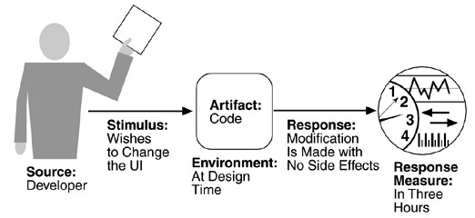
MODIFIABILITY

Slide 10
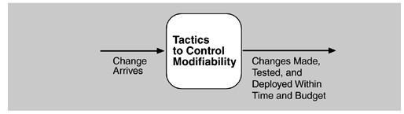
MODIFIABILITY
Tactics to control modifiability have as their goal controlling the time and cost to implement, test, and deploy changes.
Goal of modifiability tactics
9

Slide 11
MODIFIABILITY
We organize the tactics for modifiability in sets according to their goals.
  One set has as its goal reducing the number of modules that are directly affected by a change. We call this set "localize modifications."
  A second set has as its goal limiting modifications to the localized modules. We use this set of tactics to "prevent the ripple effect."
  Implicit in this distinction is that there are modules directly affected (those whose responsibilities are adjusted to accomplish the change) and modules indirectly affected by a change (those whose responsibilities remain unchanged but whose implementation must be changed to accommodate the directly affected modules).
  A third set of tactics has as its goal controlling deployment time and cost. We call this set "defer binding time."
10

Slide 12
Modifiability Tactics-localize modifications
The goal of tactics in this set is to assign responsibilities to modules during design such that anticipated changes will be limited in scope. We identify the following tactics.
Maintain semantic coherence.
  semantic coherence should be measured against a set of anticipated changes. One sub-­‐tactic is to abstract common services.
Anticipate expected changes.
  The tactic of anticipating expected changes does not concern itself with the coherence of a module's responsibilities but rather with minimizing the effects of the changes.
  In reality this tactic is difficult to use by itself since it is not possible to anticipate all changes. For that reason, it is usually used in conjunction with semantic coherence.

Slide 13
Modifiability Tactics-localize modifications
Generalize the module.
  Making a module more general allows it to compute a broader range of functions based on input.
  The more general a module, the more likely that requested changes can be made by adjusting the input language rather than by modifying the module.
Limit possible options.
  Modifications, especially within a product line may be far ranging and hence affect many modules.
  Restricting the possible options will reduce the effect of these modifications. For example, a variation point in a product line may be allowing for a change of processor. Restricting processor changes to members of the same family limits the possible options.

Slide 14
Modifiability Tactics-prevent the ripple effect
A ripple effect from a modification is the necessity of making changes to modules not directly affected by it.
We begin our discussion of the ripple effect by discussing the various types of dependencies that one module can have on another. We identify eight types:
  Syntax of
    data. For B to compile (or execute) correctly, the type (or format) of the data that is produced by A and consumed by B must be consistent with the type (or format) of data assumed by B.
    service. For B to compile and execute correctly, the signature of services provided by A and invoked by B must be consistent with the assumptions of B.

Slide 15
Modifiability Tactics-prevent the ripple effect
Semantics of
  data. For B to execute correctly, the semantics of the data produced by A and consumed by B must be consistent with the assumptions of B.
  service. For B to execute correctly, the semantics of the services produced by A and used by B must be consistent with the assumptions of B.
Sequence of
  data. For B to execute correctly, it must receive the data produced by A in a Hixed sequence. For example, a data packet's header must precede its body in order of reception (as opposed to protocols that have the sequence number built into the data).
  control. For B to execute correctly, A must have executed previously within certain timing constraints. For example, A must have executed no longer than 5ms before B executes.

Slide 16
Modifiability Tactics-prevent the ripple effect
Identity of an interface of A.
  A may have multiple interfaces. For B to compile and execute correctly, the identity (name or handle) of the interface must be consistent with the assumptions of B.
Location of A (runtime).
  For B to execute correctly, the runtime location of A must be consistent with the assumptions of B. For example, B may assume that A is located in a different process on the same processor.
Quality of service/data provided by A.
  For B to execute correctly, some property involving the quality of the data or service provided by A must be consistent with B's assumptions. For example, data provided by a particular sensor must have a certain accuracy in order for the algorithms of B to work correctly.

Slide 17
Modifiability Tactics-prevent the ripple effect
Existence of A.
  For B to execute correctly, A must exist. For example, if B is requesting a service from an object A, and A does not exist and cannot be dynamically created, then B will not execute correctly.
Resource behavior of A.
  For B to execute correctly, the resource behavior of A must be consistent with B's assumptions. This can be either resource usage of A (A uses the same memory as B) or resource ownership (B reserves a resource that A believes it owns).
With this understanding of dependency types, we can now discuss tactics available to the architect for preventing the ripple effect for certain types.

Slide 18
Modifiability Tactics-prevent the ripple effect
Notice that none of our tactics necessarily prevent the ripple of semantic changes.
Hide information.
  This is the oldest technique for preventing changes from propagating.
  It is strongly related to "anticipate expected changes" because it uses those changes as the basis for decomposition.
Maintain existing interfaces.
  If B depends on the name and signature of an interface of A, maintaining this interface and its syntax allows B to remain unchanged.

Slide 19
Modifiability Tactics-prevent the ripple effect
Patterns that implement this tactic include
  adding interfaces. Most programming languages allow multiple interfaces. Newly visible services or data can be made available through new interfaces, allowing existing interfaces to remain unchanged and provide the same signature.
  adding adapter. Add an adapter to A that wraps A and provides the signature of the original A.
  providing a stub A. If the modiHication calls for the deletion of A, then providing a stub for A will allow B to remain unchanged if B depends only on A's signature.

Slide 20
Modifiability Tactics-prevent the ripple effect
Restrict communication paths.
  Restrict the modules with which a given module shares data. That is, reduce the number of modules that consume data produced by the given module and the number of modules that produce data consumed by it.
  This will reduce the ripple effect since data production/consumption introduces dependencies that cause ripples. (Flight Simulation) discusses a pattern that uses this tactic.
Use an intermediary.
  If B has any type of dependency on A other than semantic, it is possible to insert an intermediary between B and A that manages activities associated with the dependency.
  All of these intermediaries go by different names, but we will discuss each in terms of the dependency types we have enumerated.
  As before, in the worst case, an intermediary cannot compensate for semantic changes. The intermediaries are

Slide 21
Modifiability Tactics-prevent the ripple effect
data (syntax).
  Repositories (both blackboard and passive) act as intermediaries between the producer and consumer of data. The repositories can convert the syntax produced by A into that assumed by B. Some publish/subscribe patterns (those that have data Hlowing through a central component) can also convert the syntax into that assumed by B. The MVC and PAC patterns convert data in one formalism (input or output device) into another (that used by the model in MVC or the abstraction in PAC).
service (syntax).
  The facade, bridge, mediator, strategy, proxy, and factory patterns all provide intermediaries that convert the syntax of a service from one form into another. Hence, they can all be used to prevent changes in A from propagating to B.
identity of an interface of A.
  A broker pattern can be used to mask changes in the identity of an interface. If B depends on the identity of an interface of A and that identity changes, by adding that identity to the broker and having the broker make the connection to the new identity of A, B can remain unchanged.
20

Slide 22
Modifiability Tactics-prevent the ripple effect
location of A (runtime).
  A name server enables the location of A to be changed without affecting B. A is responsible for registering its current location with the name server, and B retrieves that location from the name server.
resource behavior of A or resource controlled by A.
  A resource manager is an intermediary that is responsible for resource allocation. Certain resource managers (e.g., those based on Rate Monotonic Analysis in real-­‐time systems) can guarantee the satisfaction of all requests within certain constraints. A, of course, must give up control of the resource to the resource manager.
existence of A.
  The factory pattern has the ability to create instances as needed, and thus the dependence of B on the existence of A is satisHied by actions of the factory.

Slide 23
Modifiability Tactics-defer binding time
Our modifiability scenarios include two elements that are not satisHied by reducing the number of modules to be changed
  time to deploy and allowing non-­‐developers to make changes.
Many tactics are intended to have impact at lead-­‐time or runtime, such as the following.
  Runtime registration supports plug-­‐and-­‐play operation at the cost of additional overhead to manage the registration. Publish/subscribe registration, for example, can be implemented at either runtime or load time.
  Configuration Files are intended to set parameters at startup.
  Polymorphism allows late binding of method calls.
  Component replacement allows load time binding.
  Adherence to deHined protocols allows runtime binding of independent processes

Slide 24
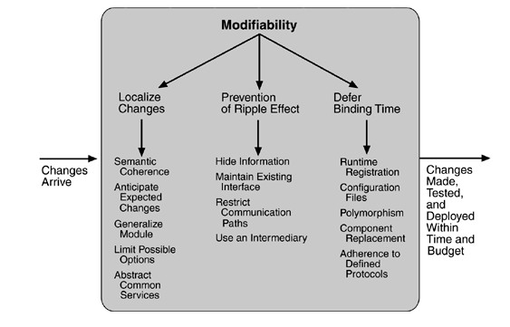
Modifiability Tactics-Summary

Slide 25
SECURITY
Security is a measure of the system's ability to resist unauthorized usage while still providing its services to legitimate users.
– An attempt to breach security is called an attack and can take a number of forms.
Security can be characterized as a system providing nonrepudiation, confidentiality, integrity, assurance, availability, and auditing. For each term, we provide a definition and an example.

Slide 26
SECURITY
Nonrepudiation
  is the property that a transaction (access to or modiHication of data or services) cannot be denied by any of the parties to it.
  This means you cannot deny that you ordered that item over the Internet if, in fact, you did.
Confidentiality
  is the property that data or services are protected from unauthorized access.
  This means that a hacker cannot access your income tax returns on a government computer.

Slide 27
SECURITY
Integrity
  is the property that data or services are being delivered as intended.
  This means that your grade has not been changed since your instructor assigned it.
Assurance
  is the property that the parties to a transaction are who they purport to be.
  This means that, when a customer sends a credit card number to an Internet merchant, the merchant is who the customer thinks they are.

Slide 28
SECURITY
Availability
  is the property that the system will be available for legitimate use.
  This means that a denial-­‐of-­‐service attack won't prevent your ordering this book.
Auditing
  is the property that the system tracks activities within it at levels sufHicient to reconstruct them.
  This means that, if you transfer money out of one account to another account, in Switzerland, the system will maintain a record of that transfer.

Slide 29
SECURITY
Source of stimulus.
  The source of the attack may be either a human or another system. It may have been previously identiHied (either correctly or incorrectly) or may be currently unknown.
  The attack itself is unauthorized access, modiHication, or denial of service.
Stimulus.
  The stimulus is an attack or an attempt to break security.
  We characterize this as an unauthorized person or system trying to display information, change and/or delete information, access services of the system, or reduce availability of system services.
Artifact.
  The target of the attack can be either the services of the system or the data within it.
Environment.
  The attack can come when the system is either online or ofHline, either connected to or disconnected from a network, either behind a Hirewall or open to the network.

Slide 30
SECURITY
Response.
  Using services without authorization or preventing legitimate users from using services is a different goal from seeing sensitive data or modifying it. Thus, the system must authorize legitimate users and grant them access to data and services, at the same time rejecting unauthorized users, denying them access, and reporting unauthorized access.
Response measure.
  Measures of a system's response include the difHiculty of mounting various attacks and the difHiculty of recovering from and surviving attacks.

Slide 31
SECURITY
Possible Values
Individual or system that is correctly identified, identified incorrectly, of unknown identity who is internal/external, authorized/not authorized with access to limited resources, vast resources
Tries to display data, change/delete data, access system services, reduce availability to system services
System services; data within system
Either online or offline, connected or disconnected, fire-walled or open
Portion of Scenario Source
Stimulus
Artifact Environment

Slide 32
SECURITY
Response
Authenticates user; hides identity of the user; blocks access to data and/or services; allows access to data and/or services; grants or withdraws permission to access data and/or services; records access/modifications or attempts to access/modify data/services by identity; stores data in an unreadable format; recognizes an unexplainable high demand for services, and informs a user or another system, and restricts availability of services
Time/effort/resources required to circumvent security measures with probability of success; probability of detecting attack; probability of identifying individual responsible for attack or access/modification of data and/ or services; percentage of services still available under denial-of-services attack; restore data/services; extent to which data/services damaged and/or legitimate access denied
Response Measure

Slide 33
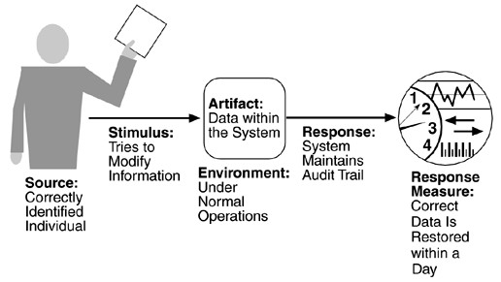
SECURITY

Slide 34
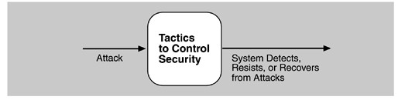
Security Tactics
Tactics for achieving security can be divided into those concerned with resisting attacks, those concerned with detecting attacks, and those concerned with recovering from attacks. All three categories are important.
Using a familiar analogy, putting a lock on your door is a form of resisting an attack, having a motion sensor inside of your house is a form of detecting an attack, and having insurance is a form of recovering from an attack.
Goal of security tactics

Slide 35
Security Tactics-resisting attacks
we identified
  nonrepudiation, confidentiality, integrity, and assurance as goals in our security characterization.
The following tactics can be used in combination to achieve these goals.
  Authenticate users.
  Authorize users.
  Maintain data confidentiality.
    Encryption
    Communication links
      virtual private network (VPN)
      Secure Sockets Layer (SSL)
  Maintain integrity.
    checksums
    hash results
  Limit exposure
  Limit access
    Firewalls

Slide 36
Security Tactics-detecting attacks
The detection of an attack is usually through an intrusion detection system.
– Such systems work by comparing network traffic patterns to a database. In the case of misuse detection, the traffic pattern is compared to historic patterns of known attacks. In the case of anomaly detection, the trafHic pattern is compared to a historical baseline of itself. Frequently, the packets must be filtered in order to make comparisons. Filtering can be on the basis of protocol, TCP flags, payload sizes, source or destination address, or port number.
Intrusion detectors must have some sort of sensor to detect attacks, managers to do sensor fusion, databases for storing events for later analysis, tools for offline reporting and analysis, and a control console so that the analyst can modify intrusion detection actions.

Slide 37
Security Tactics-recovering from attacks
Tactics involved in recovering from an attack can be divided into those concerned with restoring state and those concerned with attacker identification.
The tactics used in restoring the system or data to a correct state overlap with those used for availability since they are both concerned with recovering a consistent state from an inconsistent state.
The tactic for identifying an attacker is to maintain an audit trail.

Slide 38
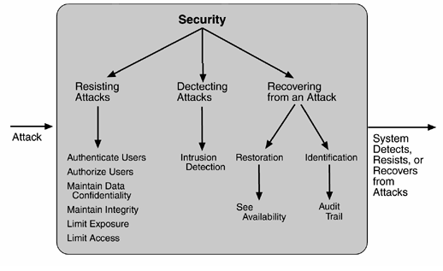
Security Tactics-Summary

Slide 39
Project
Suppose you needs to improve the modifiability & security of your SNS website. Please describe your design from the following aspects:
  If your SNS provides API for users to develop new services and plug them into your system, what tactics would you want to adopted to support such a high modifiability?
  If your want to prove the security of your SNS website to users, please tell them what tactics you have adopted to improve the security in the aspects of Nonrepudiation, Confidentiality and Assurance.

